Slide 1

Website Development
(The Final Topic in AS2)

Slide 2


Requirements
Explain how webpages are created using Hypertext Mark-Up Language (HTML)
Understand the purpose of a range of HTML tags:
  paragraph,
  image,
  anchor,
  ordered list,
  unordered list
  hyperlinks
Explain how cascading style sheet (CSS) is used in web development
Distinguish between client-side and server-side processing
Evaluate methods of ensuring security over the internet:
  encryption (including public and private keys),
  hypertext transfer protocol secure (https),
  secure sockets layer (SSL),
  digital signature or digital certificate

Slide 3
What is HTML?
Hypertext markup language (HTML) is a markup language used to create webpages and web applications. A markup language makes use of tags.
Tags: These are keywords that define the structure of a webpage and how the browser must display the content of the web page.
  The tags are not displayed.
  If a browser reads a tag that it does not understand it will ignore it.
  Without HTML tags a browser could not display text or load images.
href=“myHobbies.html”
This is called an attribute. An attribute contains further instructions on the behaviour or appearance of the tag.
Click Here to go to My Hobbies
This is the text that is displayed within the tag.
<a href=“myHobbies.html”>Click Here to go to My Hobbies</a>
<a href=“myHobbies.html”>
This is opening an anchor tag
</a>
This is closing the <a> tag

Slide 4



So, basically:
ERGS Website Design
Mr Butler | My Account | Logout
The starting tag (AKA opening tag) goes here and is surrounded in angled brackets, < and >
To end a tag, you write it just like the starting tag, but with a forward slash, /, inserted before the tag name.
<tagname>Content to be displayed can go here…</tagname>
Anything you want to actually display on screen goes here, between the opening and closing tags

Slide 5



HTML Paragraphs
The paragraph tag structures the appearance of text into paragraphs.
For example:
Paragraph TAG
Splits the text up into paragraphs, which are often separated by blink lines or start with an indent.

Slide 6
BODY TAG
BODY TAG
Defines the content of what is displayed on a web page or HTML document. This includes hyperlinks, images, and other displayable tags.
There should only be one body tag in a single web page.

Slide 7
HEADING TAGs
Heading Tags
A heading tag, such as h1, are used to display titles on a web page. h1 is the most important or main heading, with h2 being a subheading, h3 being a sub subheading, etc…

Slide 8
HTML Images
IMG TAG
Inserts an image into a web page [1] The src or URL of the image is specified [1] Alternative text can be specified [1]
It’s very important to have images in websites – they are both informative and engaging, ensuring visitors are attracted to the website.
The tag used is <img>
This is one that doesn’t have a closing tag – it is known as a self-closing tag as no text is placed on screen here. Instead, it has a few attributes to tell the browser what to display:
It requires two attributes; src and alt
  src is the URL for the image
  alt is the alternative text for the image
The ‘src’ is the source. It’s the where the image is saved. Here I have a jpeg image in the C:/ drive called ‘myimage’
The width and height attributes can also be used here to set the size of the image on screen.
The tag is img.
The ‘Alt’ attribute is text displayed in the browser if the image cannot be found or is corrupt. It’s also used for screen readers.
This is how we show it is self-closing.
<img src=“C:/myimage.jpg” alt=“My Logo” width=“64” height=“32” />

Slide 9
The Anchor Tag (Hyperlinks)
ANCHOR TAG
Specifies or identifies a link to another page or part of a webpage.
The anchor tag is used to create hyperlinks which link to other pages.
The href attribute is used for this to state where the user should go to when the anchor tag is clicked. It’s referred to as “Hyperlink reference”.
There is still the end tag.
This is still an opening tag. As said, this is an <a> tag.
The href attribute is used to say the destination i.e. where we will go when we press the link. It is not displayed in the browser. It is just the instruction of ‘where to go’
The text displayed on screen is still placed between the start tag and the end tag, and will actually be displayed in the browser.
<a href=“https://www.google.com”>Click Here to go to Google</a>

Slide 10

Hyperlinks
There are other attributes used in anchor tags to get them to achieve specific behaviours:
  The target attribute specified where to open the page.
    Target=“_blank” can be added to make the hyperlink open in a new browser window or tab
  Images can also be used as hyperlinks by wrapping an image tag in an anchor tag.
<a href=“https://www.google.com”>Click here to go to Google</a>
<a href=https://www.google.com target=“_blank”>Click here to go to Google</a>
Click here to go to Google
<a href=https://www.google.com target=“_blank”>
<img src=“C:/Users/jb/oscar.jpeg” alt=“Oscar” height=128 width=64 />
</a>

Slide 11
HTML Lists
There are two kinds of lists we can use in html.
Inside these tags, you can then embed the list items <li>
  Numbered, or ordered lists <ol> Bullet points, or unordered lists <ul>
<ol>
<li>Apples</li>
<li>Oranges</li>
<li>Bananas</li>
</ol>
Apples
Oranges
Bananas
<ul>
<li>Apples</li>
<li>Oranges</li>
<li>Bananas</li>
</ul>
Apples
Oranges
Bananas

Slide 12
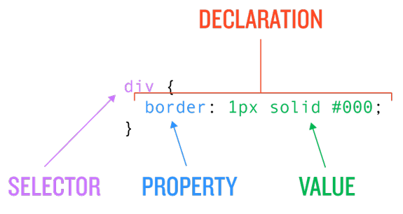
CSS
CSS (Cascading Style Sheets)
A CSS defines how the formats and appearances of HTML elements in a web page are displayed. It can be stored as a separate file which is used to control all pages on the website. Changes made to this single CSS file will affect all pages on the website.
Cascading stylesheets
CSS defines how the formats and appearances of HTML elements in a web page are displayed. It may be included as part of the web page, or it can be stored as a separate file.
When web pages are to be displayed on different devices such as mobile phones, CSS is used to define any layout differences in display.
Encourages consistent design by linking one ‘master’ stylesheet to a set of html pages. These can then be overwritten by other stylesheets and potential ambiguities are resolved by the rules for CSS.
  These rules specify the order in which definitions in one place take precedence over those in another, hence the use of the name 'cascading'.

Slide 13

There are three ways we can add CSS
INLINE STYLING
The <Style> tag
External Style Sheets
The styling is declared directly within the opening tag itself using the style attribute
Considered bad design as it can make the tags very long and also become difficult to update styles
<p style=“background: red;”>
This text will have a red background
<p>
There is actually a style tag in html
A bit better than inline styling, but this will set every paragraph to this style. We will need to start using other selectors to select specific paragraphs
<style>
p{
background: red;
}
</style>
<p>
This text will have a red background
<p>
This is the ‘standard’ way to add CSS when working with multiple stylesheets
Allows designer to edit the css in one place, and those changes are automatically reflected across all pages linked to that CSS.
<link rel="stylesheet" href="mystyle.css">
<p>
This text will have a red background
<p>

Slide 14
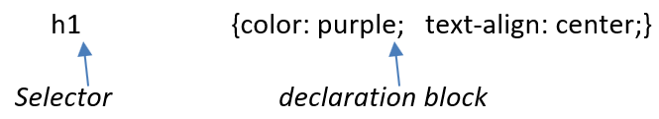
Selectors
A CSS statement is made up of a selector and a declaration block.
There are multiple Selectors you can use to ‘select’ different elements or groups of elements at the same time. For example, the above selects every heading 1 on the HTML page. However, you may wish to use a different selector if you didn’t want to select all of them.
Declaration blocks have loads of different properties you can change, and different values you can set these to. Each declaration can be split by a semicolon.

Slide 15
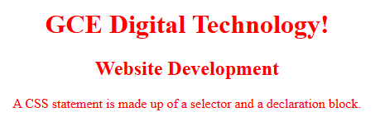
<!DOCTYPE html>
<html>
<head>
<style>
h1, h2, p {
text-align: center;
color: red;
}
</style>
</head>
<body>
<h1>GCE Digital Technology!</h1>
<h2>Website Development</h2>
<p>A CSS statement is made up of a selector and a declaration block. </p>
</body>
</html>

Slide 16
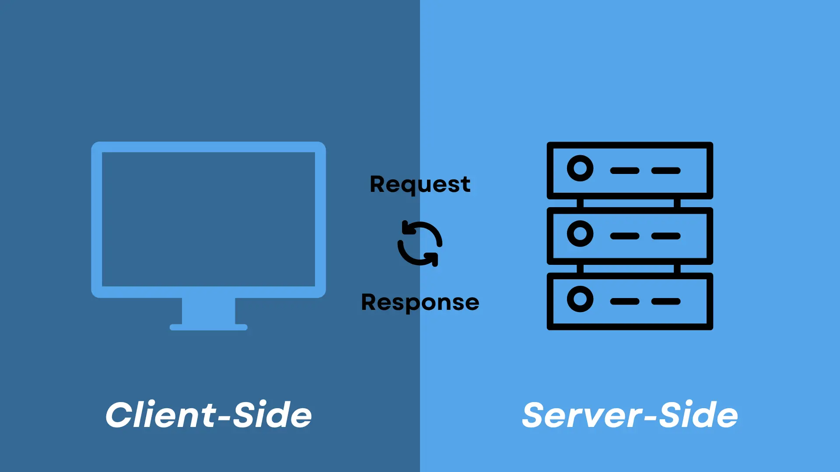
Processing
Client Side Processing
When a user is carrying out a transaction over the Internet, as much processing as possible will be done on the user’s computer
The client–server model of networking splits the processing workload between the server computer, which provides resources and services and the client computer which requests services. Applications are installed on the server and used at the client computer.
Examples of servers are web servers and file servers. Devices linked to these servers are clients
  i.e. laptops, smartphones and other mobile devices.
Client-side scripting and processing enables interaction on a webpage. The code needed to handle user-input is downloaded and executed by the browser or a plug-in on the client computer.
An example of a client-side interaction is when a user clicks on a button or enters data into a form.
  i.e. using Javascript

Slide 17

Client-side Processing
Pros | Cons
Web traffic is reduced and so less bandwidth is used. | The browser must support Javascript (most do)
Helps ensure that data sent to the server passes validation rules. | It needs technical skills to write JavaScript code from scratch, although there are plenty of JavaScript libraries such as JQuery available that reduce this burden.
Interactive widgets, such as a pop-up calendar assists the visitor to enter data correctly. | Javascript has to be enabled in order to run (some users and admins turn it off).
No delays in processing local data. | Page loading is slower as the Javascript script has to be loaded by the browser.
Reduces the load on the server as it does not have to do the processing. | Search engines will find it difficult to index a JavaScript-heavy page, as much of the content is created as the page loads.

Slide 18
Server-Side Processing
When the client-side processing is complete, the Internet server completes the processing required to complete
the transaction
Server-side scripting and processing sends data to the server across the internet. The server then runs an application that processes the information and returns the results, typically a webpage.
  PHP is a server-side programming language.
Webpages can contain interactive elements.
Processing of the interactions can be server-side or client-side.
  Data transmission can be enhanced by more client-side processing.
In the case of a travel booking, the booking form is completed and validated at the client computer then sent to the server to complete the booking.
  This is more effective as the server will receive a correctly completed booking form. It will not have to be returned due to errors on the form.
  The server can complete the booking since it has the data on availability.
Processing

Slide 19
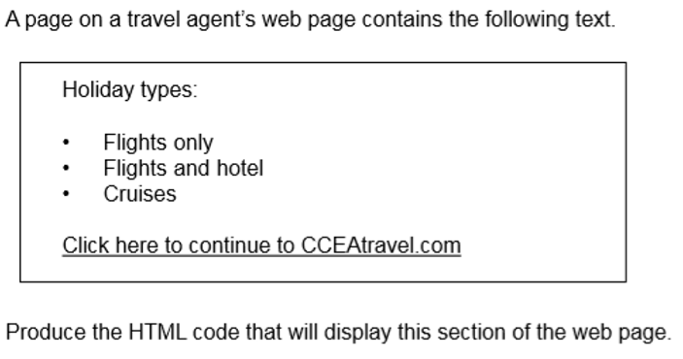

Slide 20
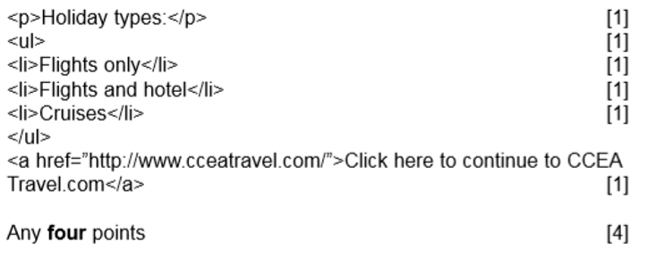

Slide 21

Ensuring security over the internet
Public & Private Keys, HTTPS, SSL, Digital Signatures and Digital Certificates

Slide 22
Why is data encrypted?
Data is encrypted to keep the data secure. This means if it is intercepted it is meaningless without the corresponding key to decrypt it.
Encryption
Used to keep the data secure. If it is intercepted it is meaningless without the key.
There is a unique mathematical relationship between a public key and its corresponding private key. Data encrypted with a public key can only be decrypted by its corresponding private key.
The public key is made available via a publicly accessible directory
The sender encrypts the data using the recipient’s public key
The private key remains confidential to its owner (the recipient).
Only the recipient has the corresponding private key to decrypt the data

Slide 23
Encryption as a method of security over the Internet
Cryptography is the science of hiding information.
  The process of transformation itself is called encryption.
  To encrypt the data an algorithm or cipher is used.
Encryption is a method of providing security for data both when it is stored electronically and whilst it is being transmitted.
  The data is ‘scrambled’ using an encryption key.
  meaningless to anyone accessing it.
The data must be decrypted using a key, so that it can be understood.
  Some systems use the same key for encryption and decryption, particularly if the number of users is small.

Slide 24



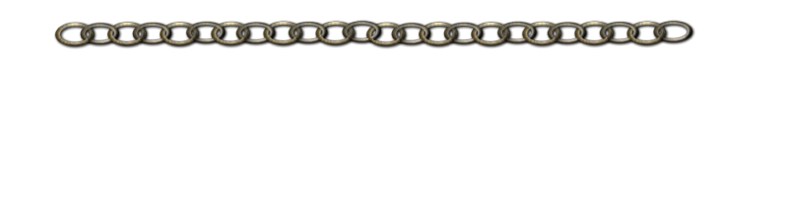
Public and Private Keys
Public Key
Public key cryptography uses two different keys, one for encrypting the data and a different one for decrypting the data.
This Public and Private key pair are linked, and both keys are needed to encrypt and decrypt data.
Private Key
The Public Key is available to everyone
The Private Key is confidential and specific to a particular receiver.
The key pair is mathematically related.
Whatever is encrypted with a Public Key may only be decrypted by its corresponding Private Key.
https://www.youtube.com/watch?v=EBmr4WCi6iQ

Slide 25
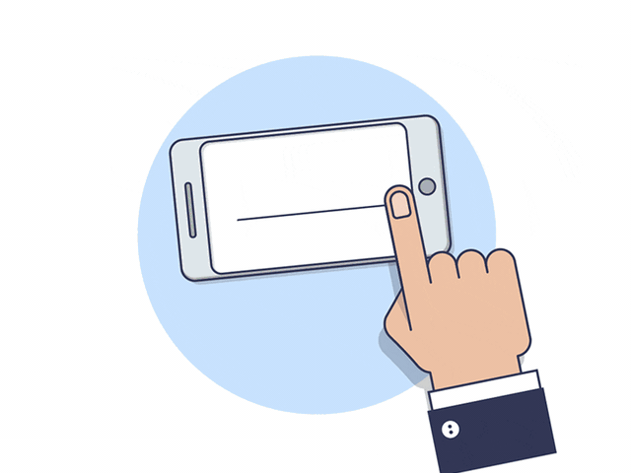
Digital Signatures
A digital signature is a part of a message that is encrypted by the sender.
It is used to confirm that the sender is who they say they are.
  The receiver first verifies the signature using the sender’s public key.
After ensuring the validity of the signature, the receiver then retrieves the data through decryption using his/her own Private Key.

Slide 26

Digital Certificates
A digital certificate is used to verify a sender’s authenticity and is widely used with websites.
Companies or individuals requiring digital certificates apply to a trusted third party called a Certificate Authority (CA), a company which provides online certification.
  i.e. Verisign.
  The CA provides an encrypted digital certificate which contains, among other things, the user’s public key. This connects an individual or website with a particular public key therefore the trusted third party verifies their identity.
When a company asks for a certificate, they give information about the web server and the location of the company.
CA will authenticate this information.
The CA authority then creates and signs the certificate. This is given back to the company who installs it on the server.

Slide 27

Browsers are shipped with information about the certificates.
The Public Key for the certificates and so they can check the authenticity of most certificates.
Digital certificates can be:
Personal
used by individuals who need secure email
Organisation
used by organisations for employees who need secure email and web transactions
Server
to prove ownership of a domain name or for use with SSL
Developer
to prove ownership of software/programs

Slide 28

HTTPS
All data transmitted across HTTP connections are in 'plain text' and can be read by any individual who can hack into the connection between a browser and a website.
Hypertext Transfer Protocol Secure(https) is used to encrypt data when it is being transferred across the Internet.
  A page displaying https:// at the beginning of the web address will make use of encryption to secure data transmission.
HTTPS web pages use SSL (or TLS –Transport Layer Security).
  During this process, a Public and Private Key are utilised together with a digital certificate.
  Ensures that if a hacker did break into the connection, they could not decrypt any of the data.

Slide 29
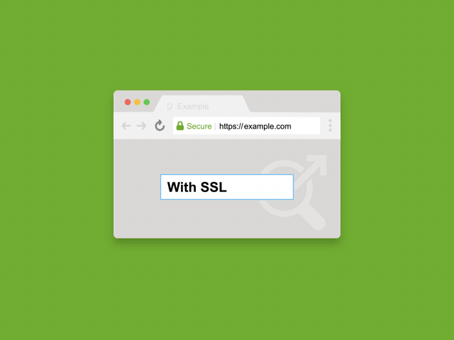
SSL
SSL is a protocol used to open a secure channel or encrypted link between two computers online.
  It is used when a web browser needs to connect securely to a web server. SSL certificates exist to encrypt data and identify websites.
  This allows a web browser to trust a website so that sensitive data can be transmitted safely. The goal is end to end trusted communication.
SSL instantly encrypts plain text like credit card numbers into data that only the user and website can decrypt.
SSL ensures that the data is not modified, and it authenticates websites.
  To verify that SSL is protecting a page, look for a web address beginning https:// and a closed padlock icon.
  Companies using an extended validation display the data in a green address bar.
  An SSL digital certificate shows that the website is secure, and visitors can be re-assured that their data will be protected whilst using it.

Slide 30
If a website is not using SSL, any data being transmitted can be accessed by any computer on the network. When doing online banking we are using SSL and HTTPS.
The following steps occur:
  The client computer requests an SSL connection
  The server answers and provides an SSL certificate which contains a public key
  The client computer validates the certificate and public key
  The client computer generates a session key and submits it to the server
  The SSL connection is established
STEP
1
STEP
2
STEP
3
STEP
4
STEP
5

Slide 31

A supermarkets web page contains the following text.
Produce the HTML code that will display this section of the webpage.
[6]

Slide 32
<body>
<p style= “font-weight: bold;”>Special offers:</p>
<br>
<ul>
<li>Buy one get one free all school stationary</li>
<li>10% off if you spend over £50</li>
<li>Discounts on marked items in clothing</li>
</ul>
<p>
<a href= “http://cceasupermarket.com”> Click here to continue to CCEAsupermarket.com</a>
</p>
</body>
[1]
Use of list [1] Correct ul tag [1]
[1]
[1]
[1]

